Slide 1

Office of the Registrar – New Chair/Director Orientation
August 11, 2021

Slide 2
Organizational Chart
Registrar
Geraldine Jones
Assistant to the Registrar
Christina Zahaj
Director, Student Recruitment
Matthew Melnyk
Associate Registrar, Enrolment Supports
Susan Guenther
Associate Registrar, Enrolment Operations
Jodi Fitzgerald
Manager, Scheduling and Examinations
Manager, Student Information and Systems
Scheduling Coordinator
Manager, Curriculum, Policy & Outreach
Manager, Brock Central
VACANT
Curriculum, Policy & Outreach Assistant (2)
Student Information and Service Advisor (9)
On Leave - 2
Director, Admissions
Christina Bosilo
Supervisor, Admissions & Systems
Admissions Officer (3)
Admissions Assistant (2)
Manager, Admissions & Assessment
Evaluations Specialist (5)
Manager, National Recruitment
Recruitment Officer - Market Development
Recruitment Officer Fall Travel/ Conversion (2)
Recruitment Officer Fall Travel (5)
Manager, Recruitment Operations & Communication
Recruitment Officer - Multimedia Web Specialist
Recruitment Officer - Communications
Recruitment Officer - Smart Start and School Group Programs
Recruitment Officer - Campus Visitor and Community Outreach
Recruitment Officer - On-Campus Events & Support
Business Analyst
Senior Records Officer
Academic Records Assistant (3)
Scheduling Assistant (2)
Scheduling and Examinations Clerk
Supervisor, Central Academic Advising
Academic Advisor (2)

Slide 3
Agenda
Quick review of units/services in the RO
Electronic grades submission
Admissions & Power BI
Student Appeals
APC training

Slide 4
Office of the Registrar
Teams
  Admissions (Domestic/International UG & Teacher Education)
  Central Academic Advising
  Brock Central (general RO inquiries, OSAP, student account questions)
  Curriculum Management, Policy & Outreach (Senate Committees, Calendar, Convocation)
  Recruitment (domestic national UG – Ontario HS, College/University transfer, out of province)
  Academic Records (grades, change of major, course restrictions, academic adjudication)
  Scheduling (SP/SU/FA/WI courses & exams, distance exams)
Conduit to facilitate any business in support of students and faculty
  Enrollment = new intake in the form of undergraduate domestic student recruitment & admissions; progression of in-progress students
  Retention = student services, support academic policy, procedure & outcomes

Slide 5
Grades
Method of grade submission is electronic (Faculty Gradebook, Brock DB)
Instructors enter/upload grades
  Can be imported from Sakai
  Once grades are entered, instructors release grades to Chair/GPD
Once grades are released, you will receive an email to your Brock email account for you to approve/release marks to the RO
  - You have received an action item
  - To electronically approve grades click on the following link:
  https://my.brocku.ca/BrockDB/fgb_ApproveMarks.aspx?DocumentHeaderID=11111

Slide 6
Grades
All grade submissions must be approved by Chair/Program Director
Grades cannot be released until this approval occurs
If email notification of grades is a concern, contact Mwinchande Chande, Manager, Student Information & Systems mchande@Brocku.ca

Slide 7
Admissions
Enrolment meetings begin with the Provost, Dean’s office and Reg. Office to set forecast goals for programs in August
September begins new application cycle
Teacher Ed & 105 open 3rd week of September
101 (Ontario HS) applicants get a ‘PIN code’ from guidance counsellors, majority apply in November/December
Admissions run ‘rolling’ offers
  First offers, begin as early as November
  Largest number of offers go out in January/February 2022
  Deadline for Ontario HS (101) to ‘accept’ offer is June 1, 2022
July/August review offer conditions for accepted students and finalize

Slide 8
Power BI
A business analytics service by Microsoft, available to you via Office365
Provides interactive visualizations and business intelligence capabilities with an interface simple enough for end users to create their own reports and dashboards
Performs functions of data sourcing and preparation, data analysis and data visualization.
Existing dashboards you can request access to include: Admissions Dashboards and Enrollment Dashboards

Slide 9
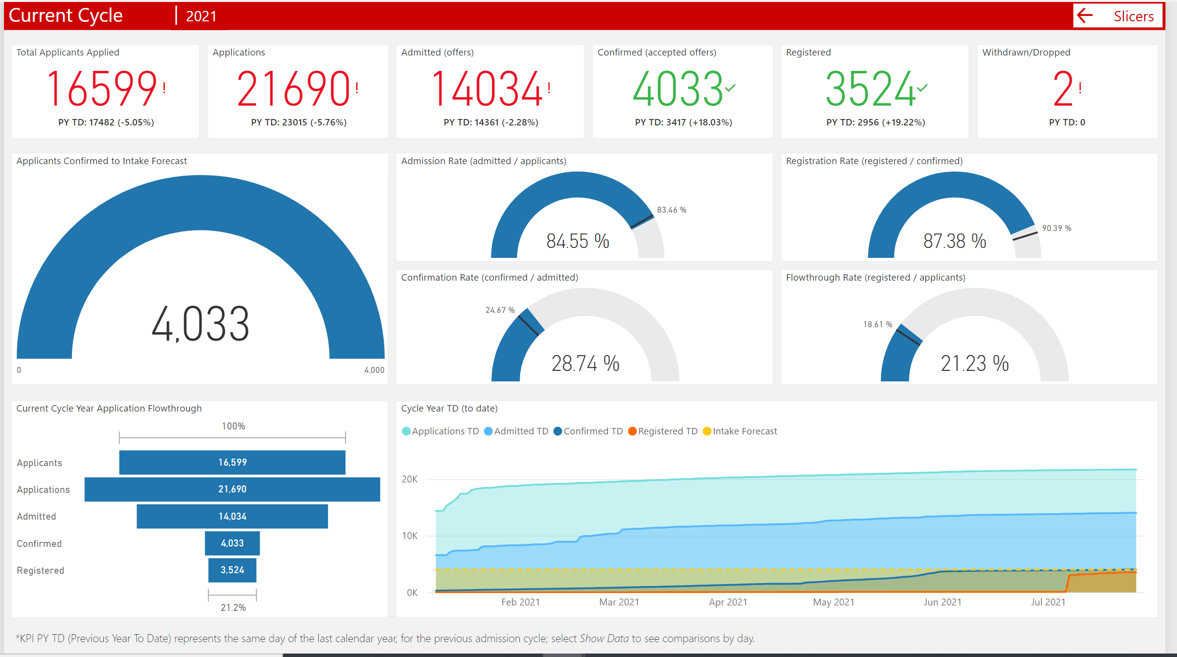
Admissions Dasboard

Slide 10
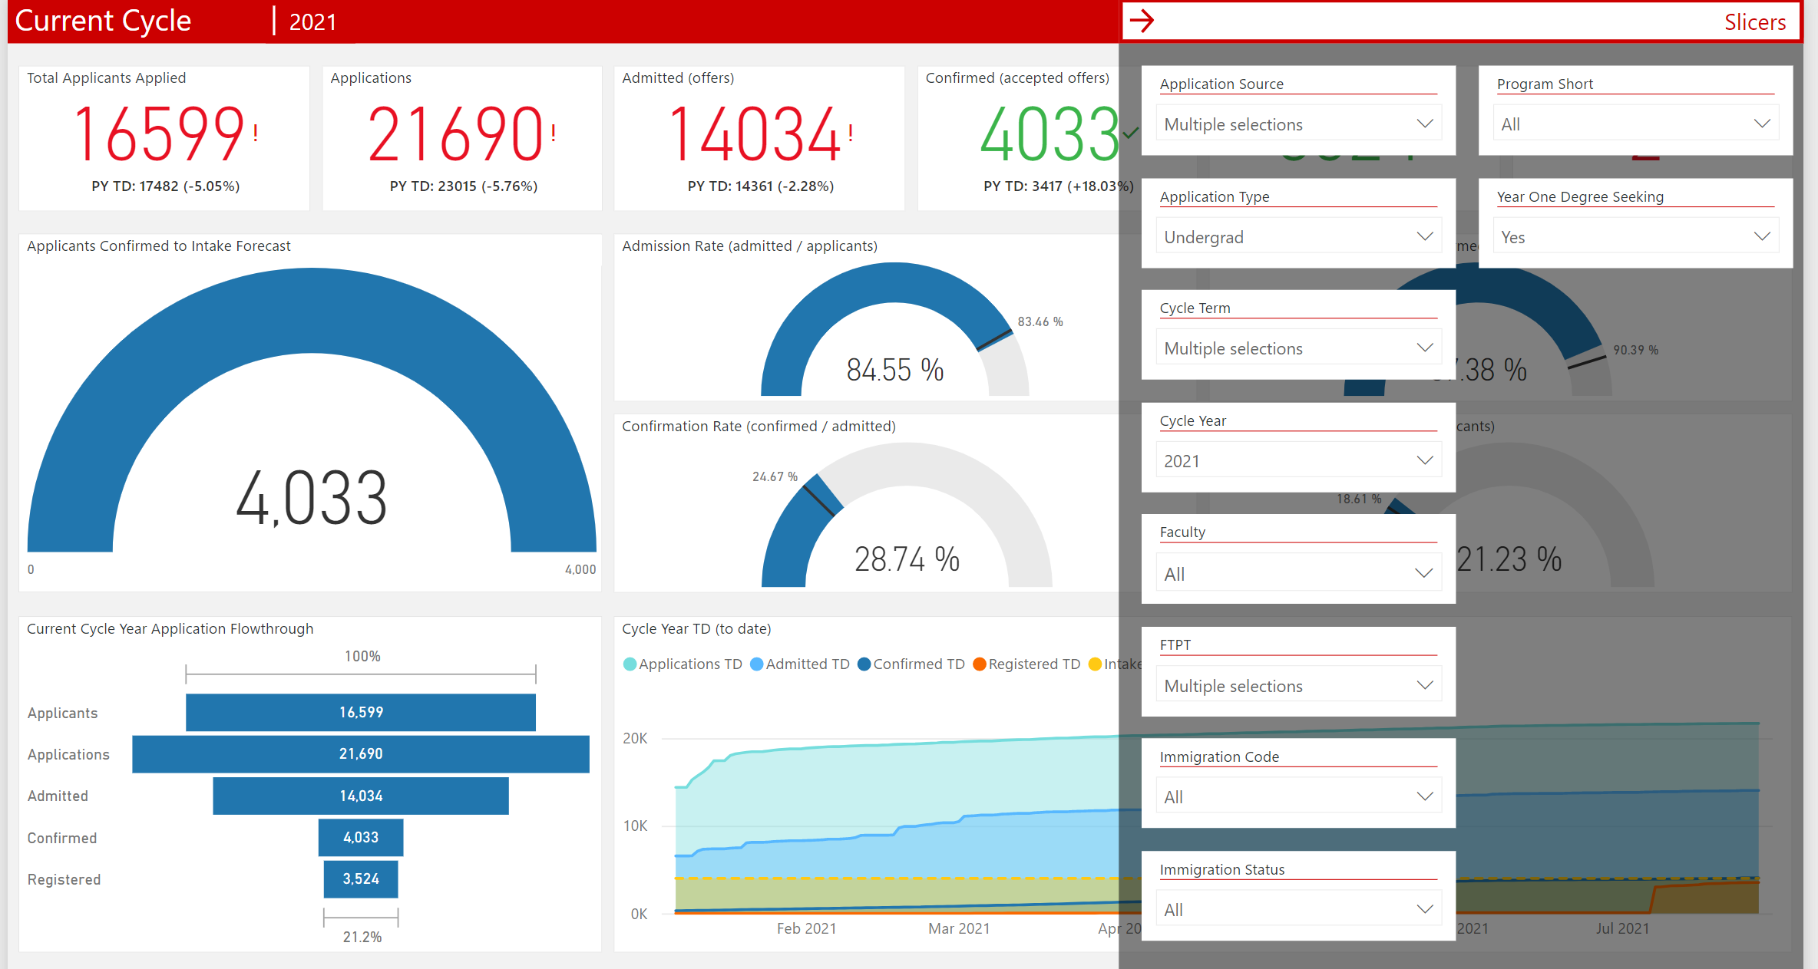
Slicers
Notes:
Can view program specific data

Slide 11
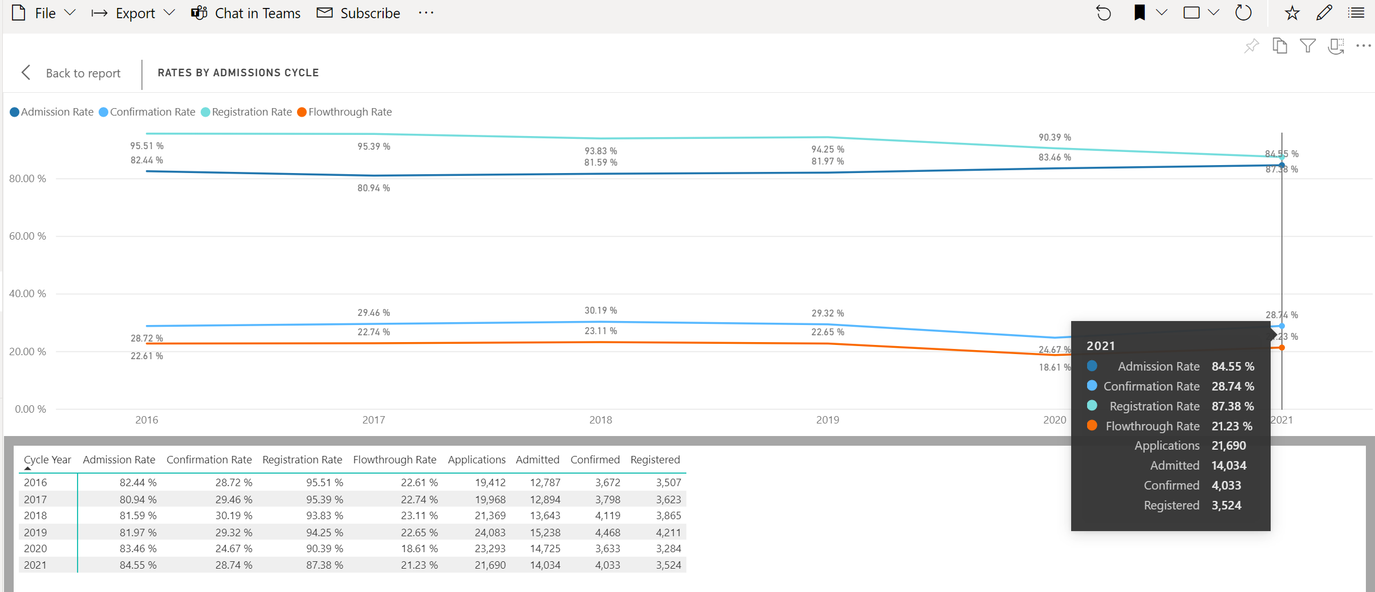
Cycle Comparisons
Notes:
Can view year over year data

Slide 12
Access to PowerBI Sessions
Interested in PowerBI access?
  Submit your Security Access Request Form via BrockDB for access to this tool
  Once approved, you can access Power BI through Office 365

Slide 13
Student Appeals
Appeals to the SAB is the final recourse in dealing with academic appeals
FHB section 3C-17 outlines appeal types, appeal methods, and appeal hearing protocol and procedures
Appeals are submitted through Brock DB student portal
Fees for applications have been eliminated
Recently enhanced webpage, form and resources available to help students and staff- (https://brocku.ca/registrar/senate_appeals/)
Notes:
FHB III:C:17 https://brocku.ca/university-secretariat/faculty-handbook/section-3/#17._appeals
Academic Calendar, Academic Regulations and University Policies VIII. Appeals
(https://brocku.ca/webcal/current/undergrad/areg.html#sec72)
​
Previous fees (for reference, if needed)
$50 for Misconduct, Grade Appeals, Backdated Withdrawals
$25 for Suspension, Debarment and Academic Regulation or Policy

Slide 14
Student Appeals
Types of Appeals:
Grades
Process: Instructor4Chair/Director4Dean4Student Appeals
Academic requirements/decisions
Process: Chair/Director4Dean4Student Appeals
Retroactive registration and backdated withdrawal
Process: Registrar4Dean4Student Appeals
Charges of Academic Misconduct*
Process: Instructor4Chair/Director4Dean4Student Appeals
Special Consideration (Suspension, Debarment, Permanent Debarment)
*with misconduct Chairs/Director may be involved in the investigation and decision-making;
but officially the decision is rendered by the Dean’s office
Resources:
FHB III:A:5 and C:17 https://brocku.ca/university-secretariat/faculty-handbook/section-3/
Academic Calendar, Academic Regulations and University Policies VIII. Appeals
(https://brocku.ca/webcal/current/undergrad/areg.html#sec72)
Notes:
Appeal of grades – must be made within 90 days of date of release of final grades
Appeals of retroactive reg or BDW – within 90 calendar days of the last day of examinations > supporting documentation must be provided. Fee considerations available via BDW procedure and is separate for academic decision. Fee consideration petitions are reviewed and evaluated a committee in SAFA.

Slide 15
Student Appeals
Pre-Appeal procedures and timelines chart created in Spring 2021 and approved by Senate Available as an Appendix in the FHB
(https://brocku.ca/university-secretariat/wp-content/uploads/sites/82/Appeals_Pre-Appeals-Procedure-Timeline_Appendix-1-approved-Senate-691.pdf)

Slide 16
Student Appeals Committee
Current Chair is Kate Bezanson, Associate Dean, Social Sciences
Current Vice-Chair is Amy Friend, Associate Professor, Visual Arts
Committee consists of 3 Senators; 2 Members-at-Large; Vice-Provost and AVP, Academic; ex-Officio member; Grad & UG student members, etc.
Committee Secretary is Diana Huson, Manager, Curriculum Management, Policy & Outreach
Teams/SharePoint site developed for committee member training and reference purposes
Notes:
Training & onboarding of new Committee members occurred in July
Meetings occur on very regular basis, typically 1-2 times per month

Slide 17
Undergraduate Program
Calendar Committee
Undergraduate calendar changes are managed via on-line submission (Academic Program Calendar - APC system)
Deadline for submissions
  Department = 3rd Friday in October = October 15
  Dean’s deadline = October 31
Senate’s Undergraduate Program Committee meets regularly to review submissions
Within UPC, small sub-committees are struck to review each Faculty submission
UPC submission goes forward to Senate for final approval
Goal is to have all major updates in place before academic calendar is released for next year (February)
For in-year submissions (current calendar updates) a manual submission process exists and UPC meets regularly to review
Notes:
(reminder academic year begins with Spring term)

Slide 18
APC System and Support
Early August, APC designates are updated and APC system is opened to begin process of editing calendar for the next year
Training presentations and resources are available on the Office of the Registrar’s SharePoint page to provide self-learning opportunities for designates

Slide 19
Support and Consultation
Designates have been added to the Microsoft Team for APC Submissions and Support
Provided with updates about timelines and supports available
Designates are able to book one-to-one consultation sessions with Curriculum Management, Policy and Outreach
Includes training for new designates, specific questions related to submissions, or consultation on larger and complex revisions (i.e. a new major or program)
Notes:
Office of the Registrars SharePoint Site
Two presentations are currently available:
UPC and the Calendar Revision Submission Process – overview of the role of UPC, deadlines for calendar submissions, and required documentation.
APC System Overview – an overview of the APC System, inputting changes, proposals and explanations. A companion guide is also available through Forms & Resources – APC Site Documentation and Instructions
APC Request for Consultation
As always, if you have any questions or concerns please do not hesitate to reach out to this e-mail (ugcalendar@brocku.ca) or through Microsoft Teams.

Slide 20
Timelines
APC system opens in early August
Designates will:
  review and revise calendar
  prepare proposals and explanations for each change in APC
  Collect all necessary supporting documents to be forwarded to Curriculum Management, Policy and Outreach (Library Support forms, Verification of Consultation, etc).
Submissions (including supporting documents) are due to the Dean the 3rd Friday in October through the APC system
The Dean will review all Department/Centre submissions and submit final Faculty submission to Curriculum Management by October 31

Slide 21
Wrap-up
Questions?
Key contacts:
  Jodi Fitzgerald, Associate Registrar, Enrollment Operations
  Diana Huson, Manager, CM, Policy & Outreach
  Susan Guenther, Associate Registrar, Enrollment Services
  Mwinchande Chande, Manager, Student Information & Systems
  Christina Bosilo, Director, Admissions
  Michelle Knapman, Manager, Admissions & Assessment

