Slide 1
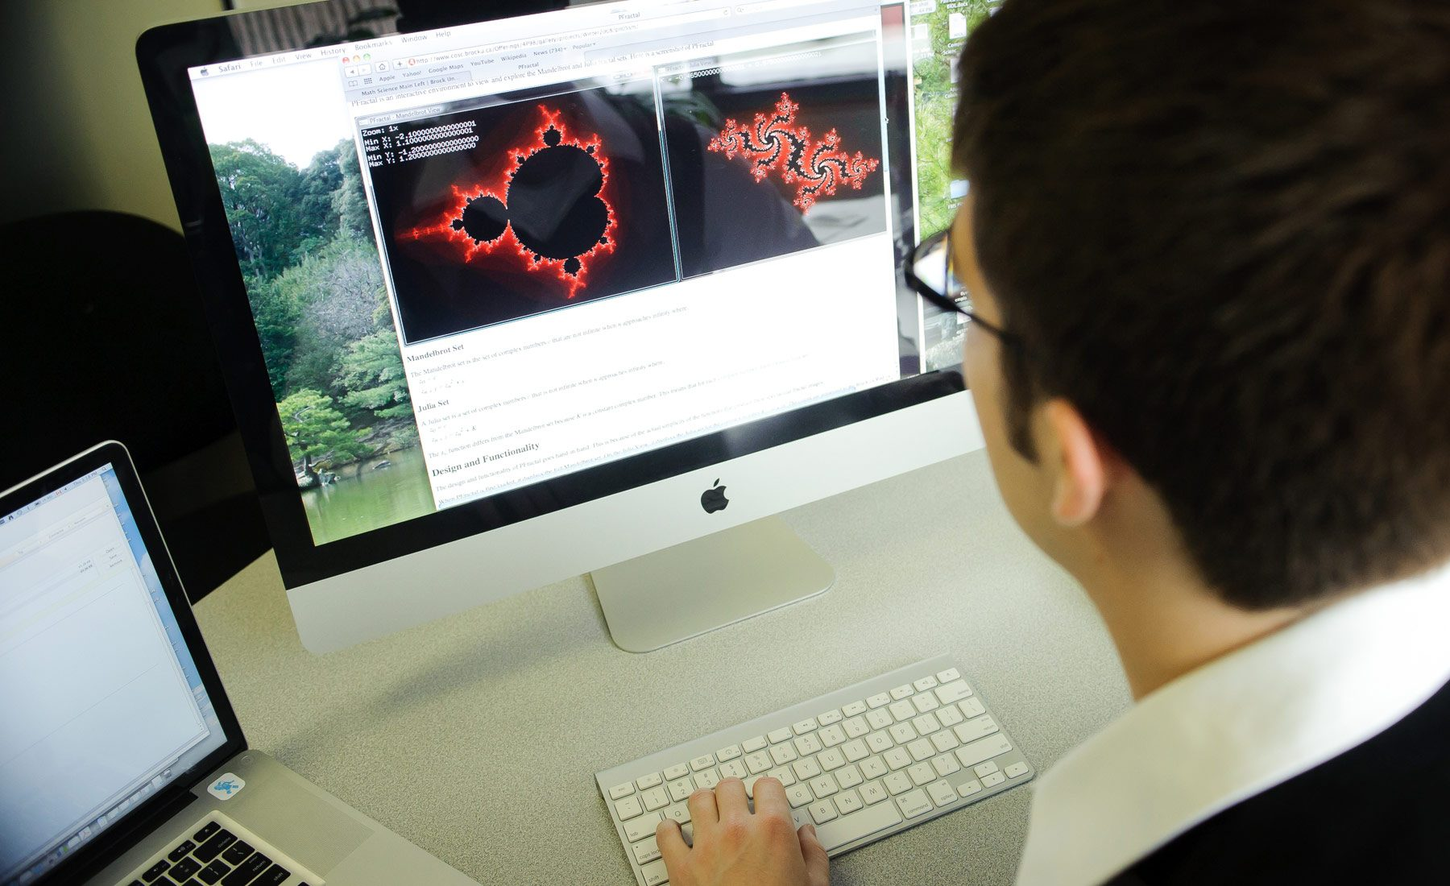


Experience Mathematics and Statistics

Slide 2
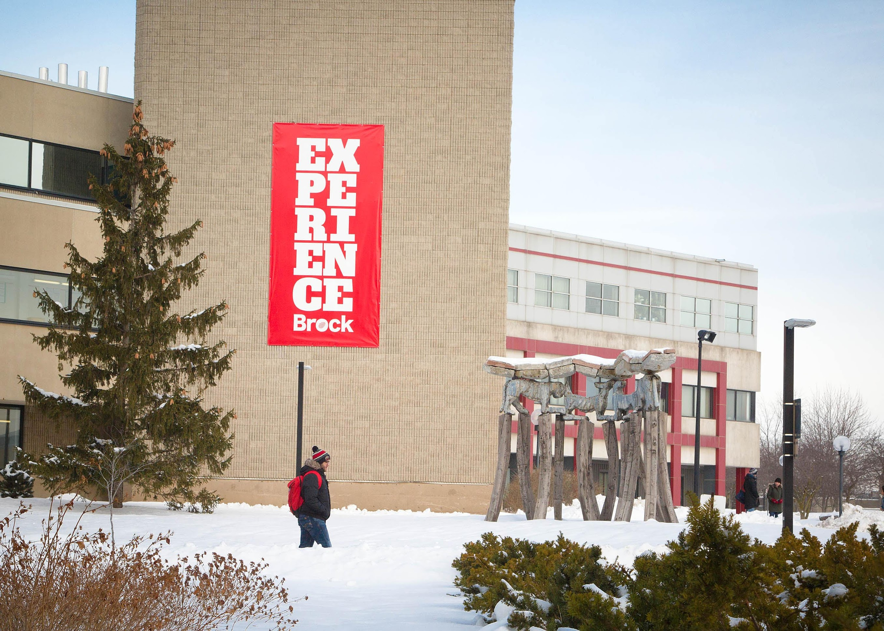
Contact us:
mathchair@brocku.ca

Slide 3
Department of Mathematics & Statistics
“I am a transfer student and something I believe is that the professors at Brock truly do want you to succeed. The willingness and enthusiasm I have receive on a daily basis in the Mathematics department is overwhelming. They are excited about the material and are expert at understanding how to explain.”
– MacCauley Ross, 4th Year Mathematics student

Slide 4
Department of Mathematics & Statistics
“One of the best things that I have experienced is how much the professors care. Because the class sizes are smaller, you get the chance to know your professors, and they’re so willing to help you to succeed. I have felt very supported throughout my time in this program!”
– Evelyn Miloud, 6th Year Concurrent Education student

Slide 5
Department of Mathematics & Statistics
Frequently Asked Questions
  What employment opportunities are there for our graduates?
  How large are your class sizes?
  What is your typical first year like?
  Do you have a co-op program?
  Can you combine majors with another program?
  Do you offer a minor?

Slide 6
Department of Mathematics & Statistics Department of Mathematics & Statistics
What employment opportunities are there for our graduates?
  Statistics and Data Science
    (e.g. Aviva, Sports Analytics, integrate.ai)
  Mathematical Modelling including Mathematical Finance
  (e.g. RBC, Canadian Tire Financial Services, Apotex)
  Education
    Elementary, Secondary and Post-Secondary
  But your trajectory is unique (and up to you!)
    We offer add-ons like programming and use of mathematics and statistics technology.
    Our students have many ways to grow their career options including co-op, research with faculty, and other networking opportunities.

Slide 7
Department of Mathematics & Statistics
How large are your class sizes?
  In first year, lecture sizes will be approximately 80-100 people for math courses. Lab sessions are with a Teaching Assistant that is usually around 30 students.
  In upper years, classes can be as small as 20 students. We have a collaborative culture where students, faculty and staff support each other, and professors will know students by name.

Slide 8
Department of Mathematics & Statistics
What is a student’s typical first year like?
  In the fall term, our majors will take two mathematics courses: Math 1P01 Calculus Concepts I and Math 1P11 Linear Algebra I. Some students also take Math 1P66 Mathematical Reasoning.
  In the winter term, students typically take Math 1P02 Calculus Concepts II and Math 1P40 MICA I: A course which introduces the use of programming to learn and do mathematics.

Slide 9
Department of Mathematics & Statistics
Do you have a co-op program?
  There is a Mathematics Co-op and a Statistics Co-op.
Can you combine majors with another program?
  Many options exist for combining majors, including a Mathematics and Computer Science Co-op. We highly recommend contacting your Academic Advisor to help plan this.
Do you offer a minor?
  We offer minors both in Mathematics and Statistics.
Details on all of these can be found in our Brock Course Calendar:
  https://brocku.ca/webcal/2021/undergrad/math.html

Slide 10
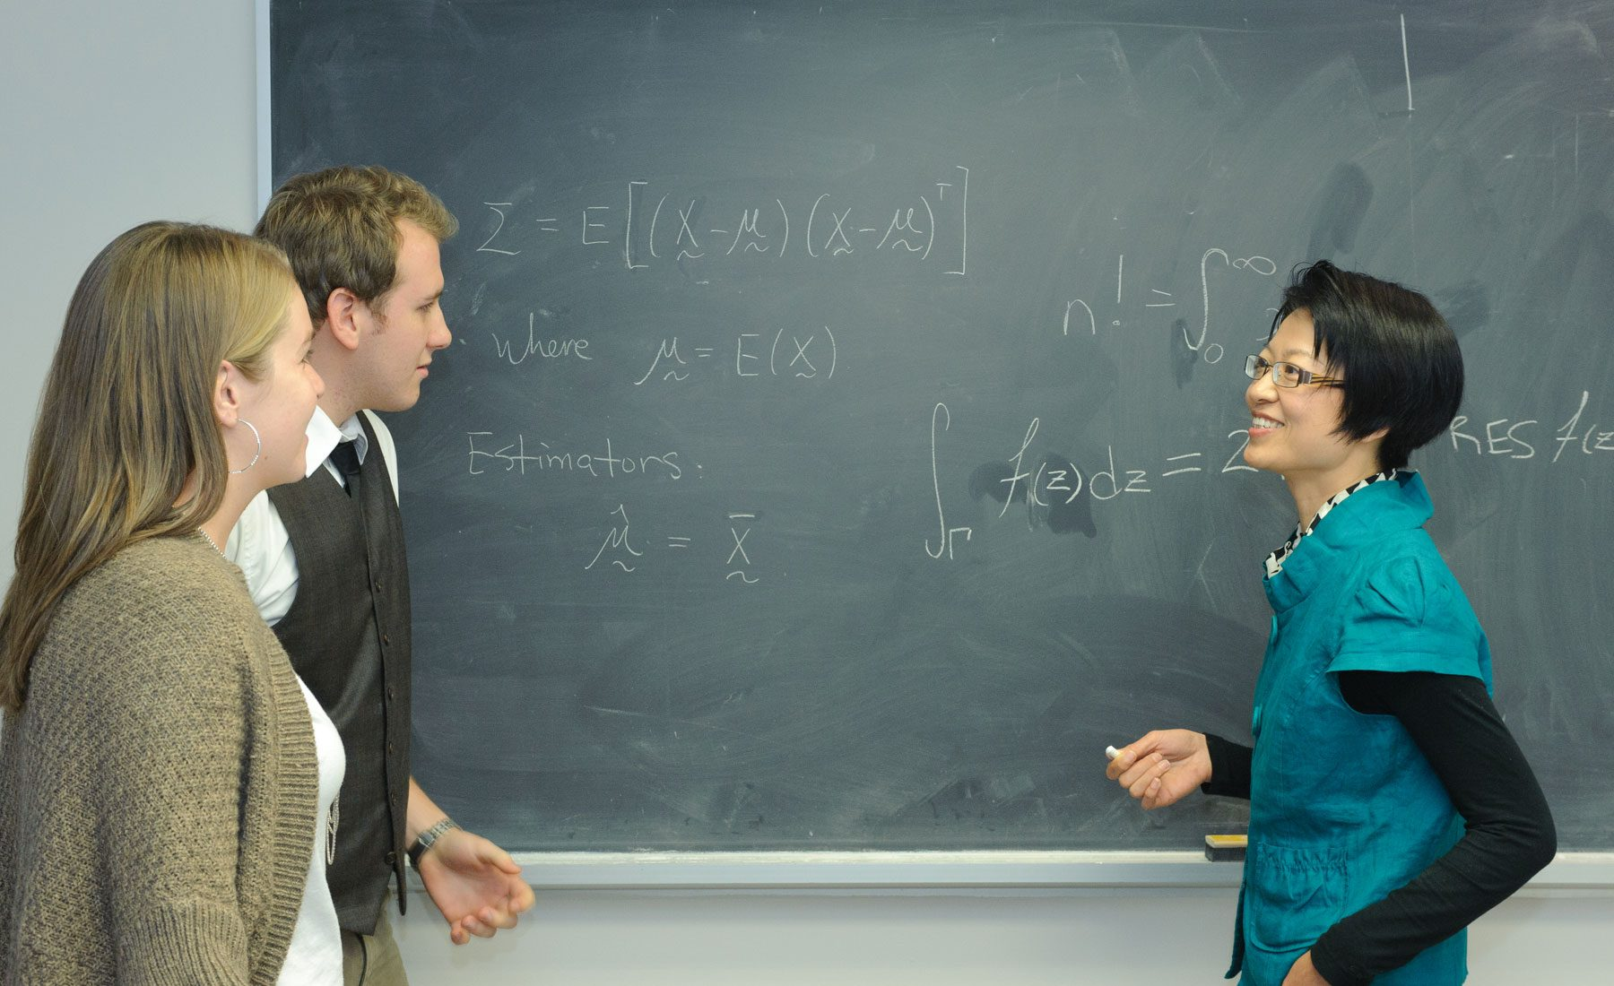
Why choose Mathematics and Statistics at Brock?

Slide 11
Department of Mathematics & Statistics
Flexibility in your Degree
  We offer many different degree concentrations
    Applied and Computational Mathematics,
    Mathematics Education
    MICA (Mathematics Integrated with
    Computers and Applications)
    Pure Mathematics
    Statistics
  General Bachelor of Science degree in Mathematics and Statistics
  We also offer an Accelerated Mathematics Studies stream that can fast-track exceptional mathematics students.

Slide 12
Department of Mathematics & Statistics
Concurrent Education
  We are a leader in teacher education in Ontario.
  Obtain your Bachelor of Science and Bachelor of Education degrees at the same time.
  Consecutive program also available for students wishing to apply for Teacher’s College after obtaining their B.Sc in Mathematics.
  Specialty courses for students pursuing teaching careers
    Euclidean and Non-Euclidean Geometry
    History of Mathematics
    Technology and Mathematics Education

Slide 13
Department of Mathematics & Statistics
Opportunities for students
  Work for faculty or the Department earning money and valuable experience for your resume
  Get involved:
    Volunteer outreach events
    Participate in peer-run activities
    Earn money as a student tutor
Research with Faculty
  Work with top Mathematics and Statistics researchers in Canada
  Undergraduate research opportunities and individual attention from faculty provide a rich and personalized learning environment
  Some of our students have obtained NSERC USRA grants to fund their undergraduate research. You may too!

Slide 14

Department of Mathematics & Statistics
Many other reasons to choose us including
  Innovative courses
  Integrate Technologies in Mathematics and Statistics
  Experiential opportunities including co-op
  Collaborative Culture and Individual one-on-one attention
  Mathematics Learning Centre

Slide 15
Department of Mathematics & Statistics
We’re proud of our Undergraduate and Graduate Students
Many have been recognized for their contributions including
    2018 Provincial University Co-op Student Award
    Board of Trustees Spirit of Brock Medal (multiple times)
    Undergraduate and Graduate Scholarships including NSERC and OGS

Slide 16
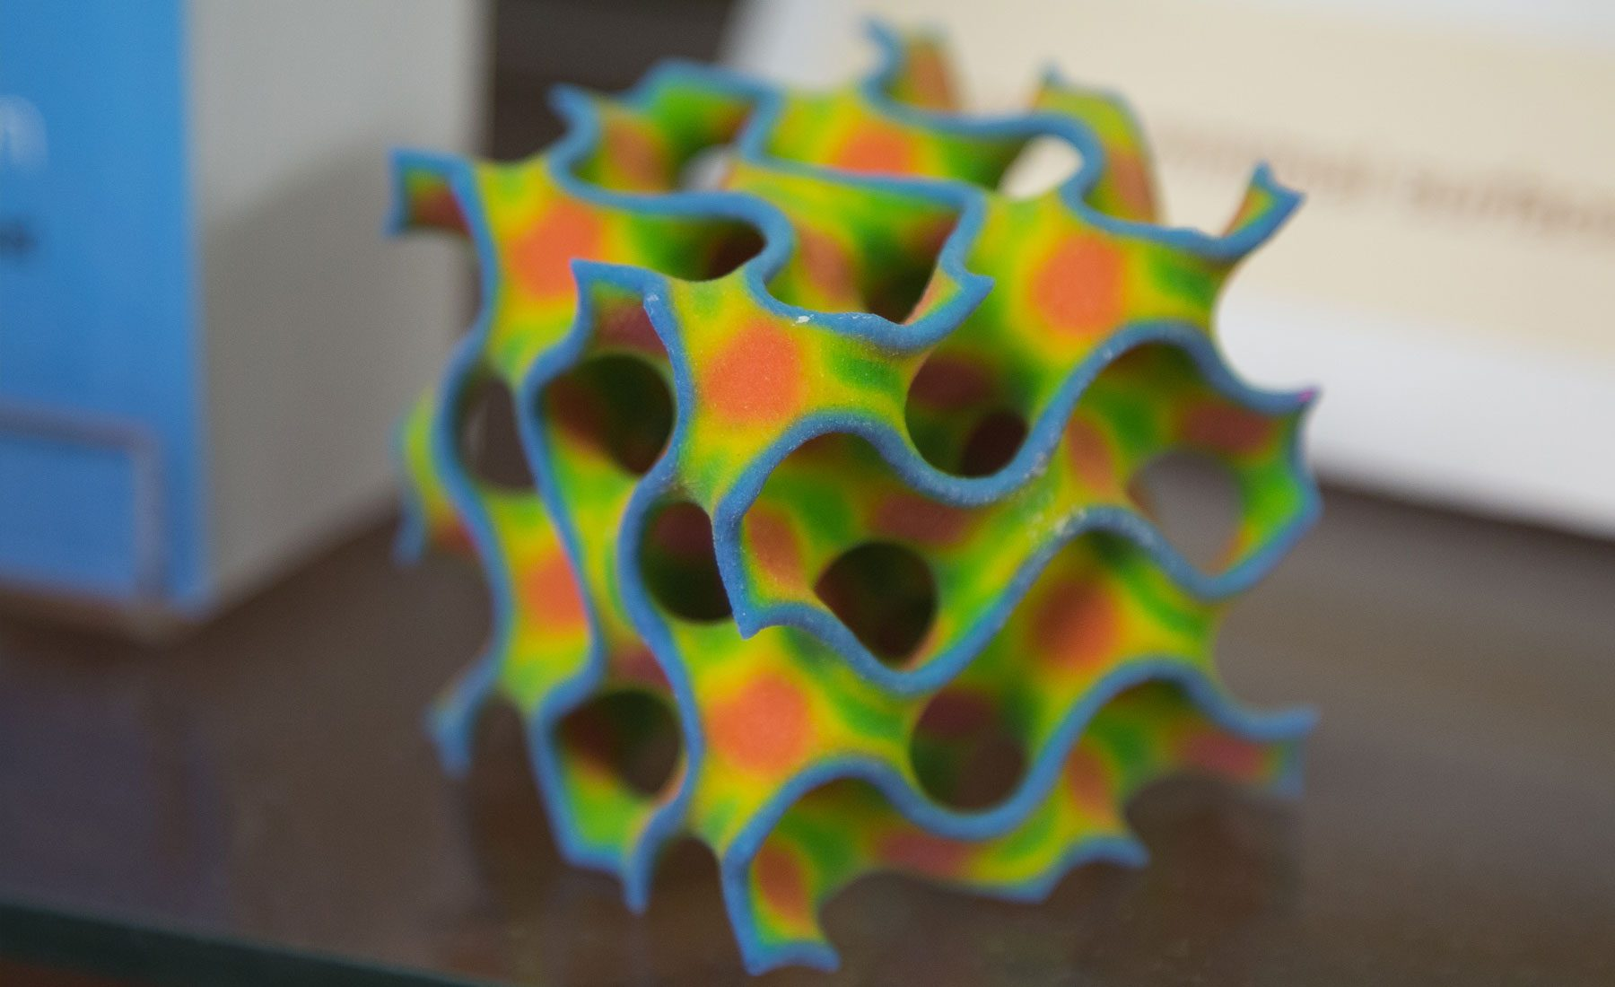
Contact us:
mathchair@brocku.ca
or
nmarshall@brocku.ca

