Slide 1


Centre for Canadian Studies
Make sure your volume is on because we have some audio on this presentation

Slide 2
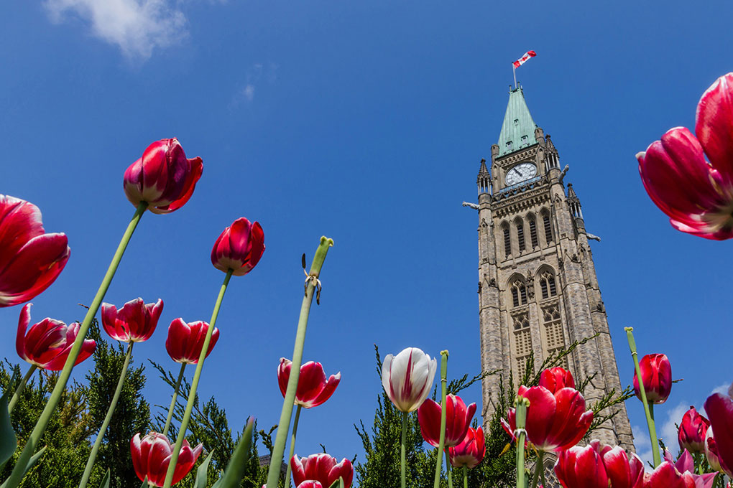








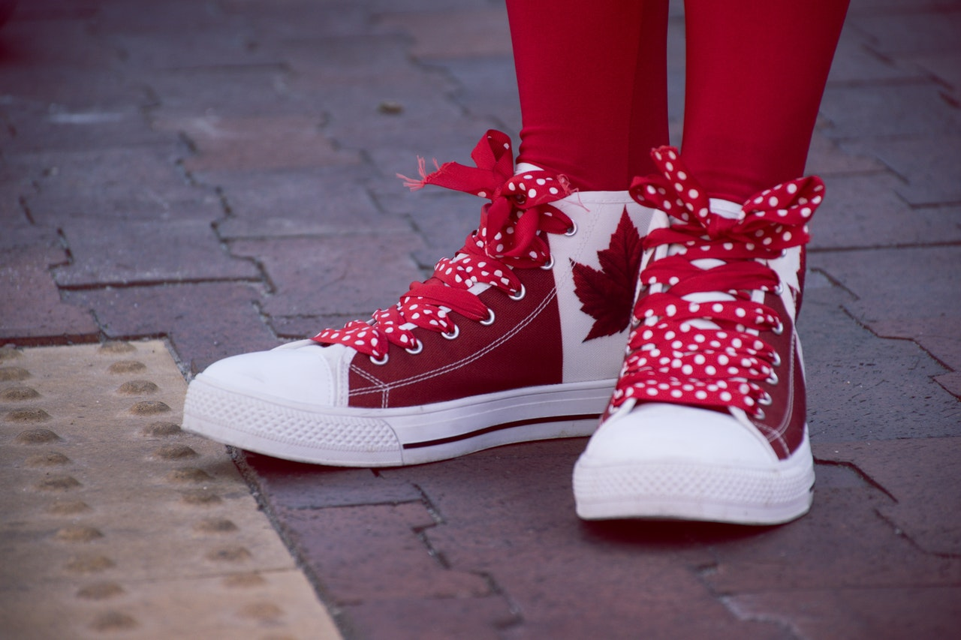
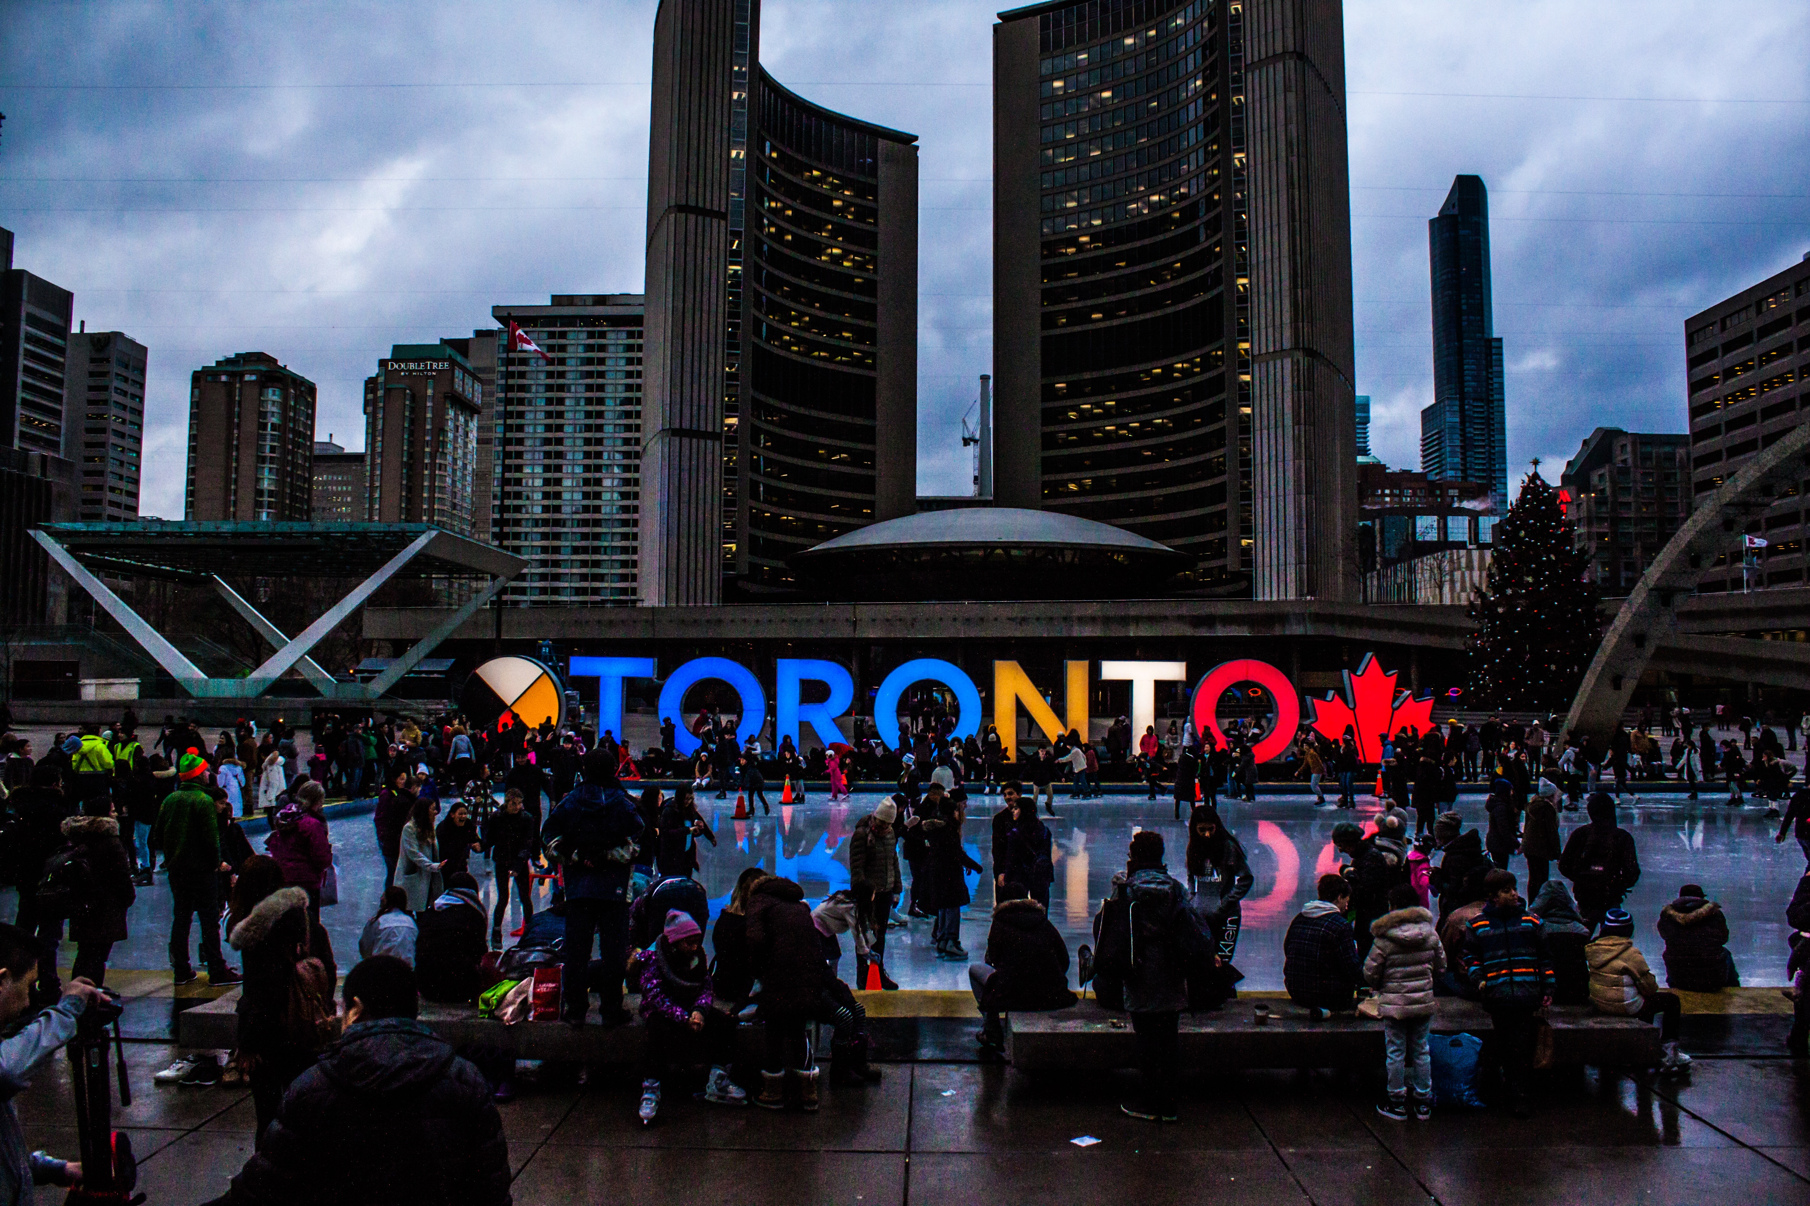
Centre for Canadian Studies

Slide 3
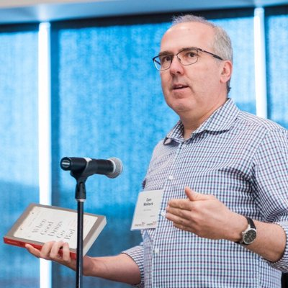
Wecome to the Centre!
A message from Dr. Dan Malleck, the director of the Centre for Canadian Studies

Slide 4
About Canadian Studies
The Centre for Canadian Studies offers a unique opportunity to study Canadian culture and society from many perspectives.
In Canadian Studies you will get to reflect on how we create meaning for the nation across time and space, among our social relationships and institutions, within and beyond our cultural and territorial boundaries.

Slide 5
Why take Canadian Studies?
Being involved in the Centre for Canadian Studies enriches your understanding of our country, while providing a range of different perspectives on the ideas, issues and events that shape Canada.
Our degrees prepare you for future careers that require insight into and knowledge about Canada. Canadian studies graduates have successful careers in education, law, politics, environmental and cultural organizations, tourism, social work, and more.

Slide 6
Who can take Canadian Studies?
Any student can take Canadian Studies!
If your program allows for combined majors (we call them “co-majors”), you can take Canadian Studies courses as your elective options during each year of study. Most programs in the Faculties of Humanities and Social Sciences allow co-majors.
But if your program does not allow co-majors, you probably can still do a minor in Canadian Studies.
(Pro tip: we insiders our program “CANA”)
Let’s look at what that means…

Slide 7
Honours BA (co-major)
How can you get more Canada on your degree? Glad you asked!
The Canadian Studies co-major draws upon teaching and research from disciplines in both the Humanities and Social Sciences.
What do you think of when you think of Canada? What do others think of?
Canadian Studies students get to explore the realities of the nation while considering various interpretations and representations of these realities. The program provides you with a critical understanding of how meanings of Canada are created, consolidated, and contested.

Slide 8
How to do a CANA Co-major:
Year 1 | Courses you take each year CANA 1F91 one POLI credit numbered 1(alpha)90 to 1(alpha)99 one credit from your co-major discipline two other credits
Year 2 | CANA 2P91 and 2P92 one credit 2(alpha)00 or above from approved Canadian Studies courses two credits from the co-major discipline one elective credit
Year 3 | CANA 3P15 one credit numbered 2(alpha)90 from Canadian Studies approved courses two credits from the co-major discipline one elective credit
Year 4 | CANA 3P95 one-half credit from CANA 3V90-3V99 one credit numbered 3(alpha)90 from Canadian Studies approved courses two credits from the co-major discipline one elective credit
(Hey, even we find these tables confusing. Don’t worry! The main point is that you need to take a few courses a year in Canadian Studies and a few in the co-major program. So if you’re doing a History and CANA co-major, you’d take some history courses. If it’s with Political Science, you’ll take some “PoliSci” courses, and so on.)

Slide 9
Minor in Canadian Studies
It’s easy to get a Minor in Canadian Studies while majoring in nearly any other program at Brock!
All you need is to make sure you complete the following courses with a minimum 60 percent overall average:
CANA 1F91, 2P91 and 2P92
one credit numbered 2(alpha)90 or above from approved Canadian Studies courses
one Canadian Studies credit numbered 3(alpha)00 or above
Did you add it up? That’s just five courses and you’ll get the highly coveted “Canadian Studies Minor” listed on your degree!

Slide 10
A sample of the courses we offer
CANA 1F91
Introduction to Canadian Studies
This course provides an interdisciplinary look at cultural expressions drawn from Canadian art, literature, and music, as well as relevant issues in Canadian social and cultural history. Two-hour lecture/week plus 1-hour seminar/week. Click here to see a short intro to Dr. Daniel Samson’s module on indigenous treaties.

Slide 11

A sample of the courses we offer
CANA 3P40
The New Niagara
You will examine Niagara’s cultural, demographic and economic changes, Niagara’s position in the world economy, economic restructuring, income inequality, free trade, deindustrialization, tourism, demographic transition and the brain drain. Click now and you’ll hear Dr. Jeffrey Boggs talk about this course.

Slide 12
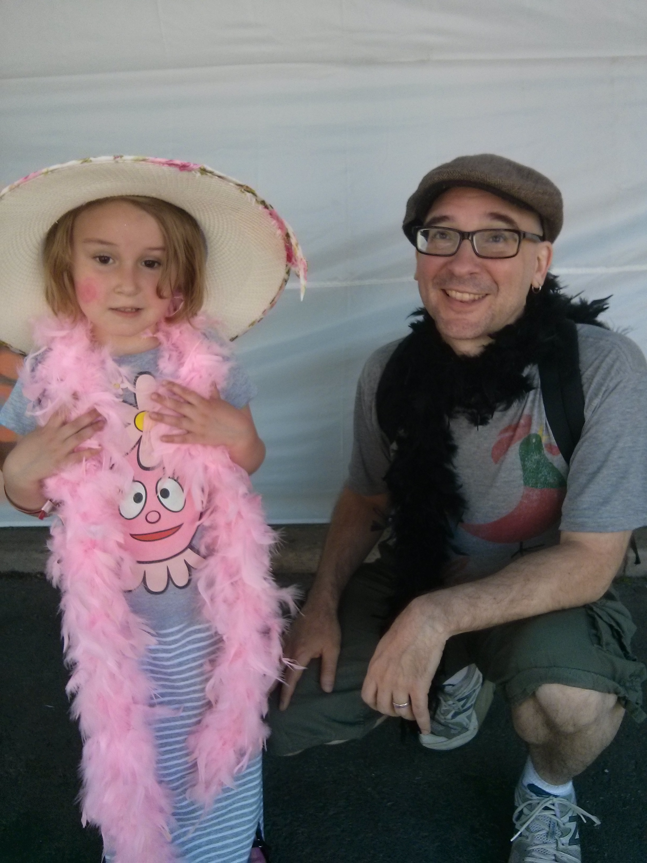
A sample of the courses we offer
CANA 3P40
The New Niagara
You will examine Niagara’s cultural, demographic and economic changes, Niagara’s position in the world economy, economic restructuring, income inequality, free trade, deindustrialization, tourism, demographic transition and the brain drain. Click now and you’ll hear Dr. Jeffrey Boggs talk about this course.
Dr. Boggs conducting fieldwork on Niagara's cultural economy with his daughter/research assistant, June 7 2015.

Slide 13

A sample of the courses we offer
CANA 3P95: Canada’s Changing Global Role
Learn about the Canadian perception of and interaction with other countries and cultures, including state-driven political, military and economic programs, global, social, and cultural exchanges, and domestic attitudes toward Canada’s global role from the late 19th Century to the present. (Don’t miss Sarah Cavanagh’s description of what she learned in this course. It’s only a few slides away…)

Slide 14

Have questions about courses?
Talk to Liz!
Liz Hay is the academic advisor for Canadian Studies (and some other programs in the Faculty of Humanities)
She knows our programs better than most of the professors (this is true!)
She can help you figure out how to get the most out of your degree
(And yes she does smile this much because she is friendly and helpful)

Slide 15
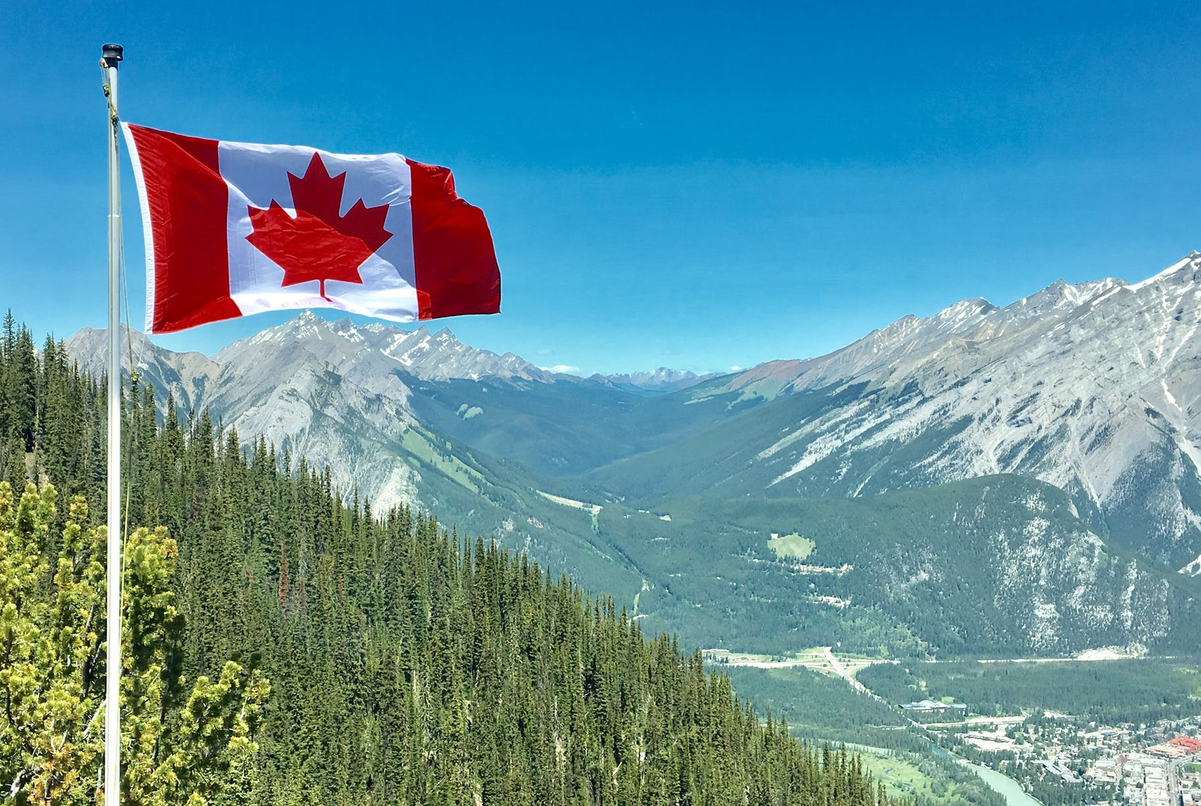
But…it’s not all about sitting in class
Attend class and do your best (of course)!
But remember, we do more than just offer courses.
The Centre for Canadian Studies has all sorts of ways for you to explore Canada and the world!
Keep going to learn about some great opportunities…

Slide 16
Student Exchange Program
You can participate in a regular student exchange program between Brock University and the University of Innsbruck in the alps of Austria.
The program is open to students in all disciplines. However, it is helpful to have background in Canadian Studies, because people are going to ask you about Canada!
You can do the exchange for one or two terms.
(You don’t have to get these shoes but if you have them people will know where you are from!)

Slide 17

European Summer School in Canadian Studies (ESSCS)
Students have the chance to attend a two week intensive summer school in Canadian Studies in Vienna and Innsbruck Austria.
The program is for students who have completed their undergraduate degree (ideally in Canadian Studies). Students receive a certificate in Canadian Studies and an amazing experience!
The ESSCS lasts for two weeks but Brock students have the chance to stay in Innsbruck for a three weeks intensive German Course in Innsbruck (fees and accommodation included).
Sehr gut, nein?!

Slide 18

What else do we do?
The Centre for Canadian Studies has many opportunities for you to become involved in a deeper understanding of Canada and its place in the world….

Slide 19
Two Days of Canada
Since 1986 the Two Days of Canada conference has been a place for scholars and students to examine specific issues in Canadian Studies.
It is an annual interdisciplinary conference that brings together scholars from across Canada and around the world to present current research in Canadian Studies. Canadian Studies students are welcome and encouraged to attend. You will meet leading thinkers from across the country and around the world, all discussing something unique about Canada!

Slide 20
Crossing Borders
Since 2008 the Centre for Canadian Studies has partnered with universities in the United States to hold Crossing Border an interdisciplinary conference. Here undergraduate and graduate students present their research on topics on cross-border relations.
The event is friendly, engaging, and a great opportunity for students to gain public presentation skills while getting to know other Canadian and American students who share their interests. It is valuable experience in getting your ideas across and learning new ways of viewing the world.

Slide 21
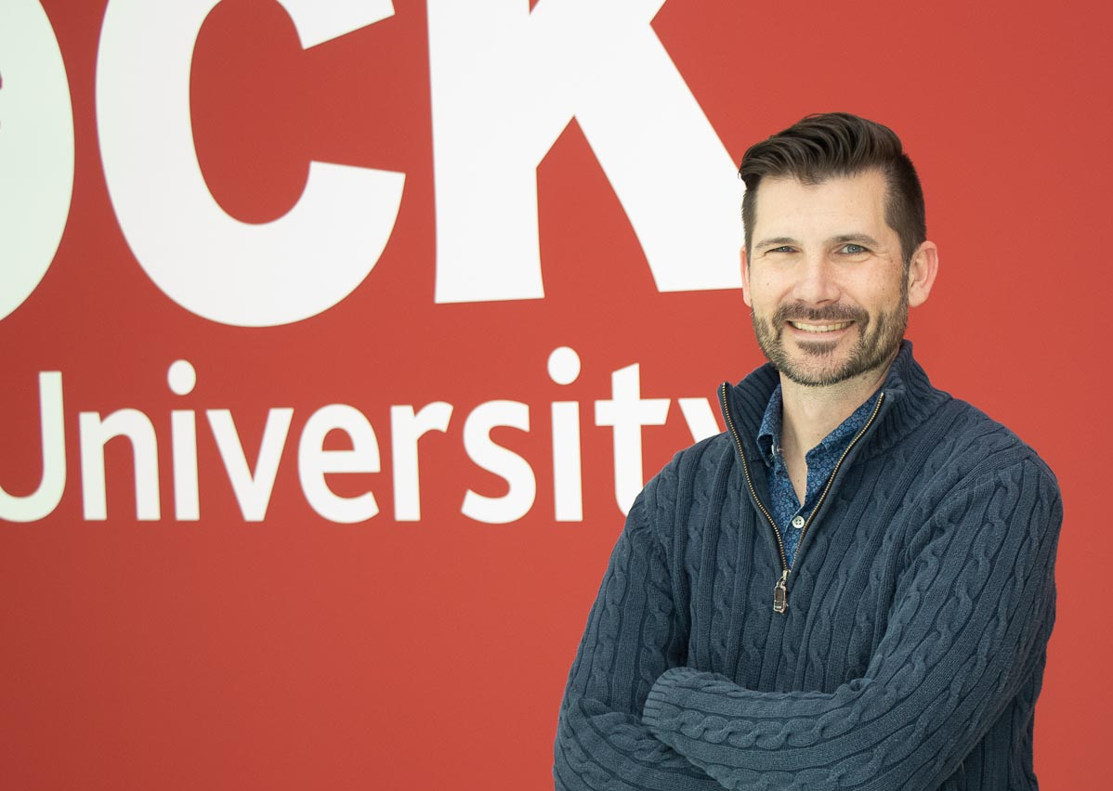
Fulbright Research Chair
Every year the Centre for Canadian Studies at Brock gets to have a internationally renowned researcher and teacher bring their expertise to the Centre. The Fulbright Research Chair in Transnational Studies teaches a special topic course, delivers guest lectures, and works with students and faculty members to enhance the great work we are doing at Brock. It keeps us international in focus right here at home!
In 2020 we hosted Dr. Jason Black. Dr Black is a professor of Communication Studies at the University of North Carolina at Charlotte. He researches social change and is especially interested in protest and indigenous resistance. While at Brock, Dr. Black taught a very popular course on social activism while researching a project about Indigenous mascots in Canada. Click now and hear Dr Black’s experience at Brock’s Centre for Canadian Studies

Slide 22
Canadian Studies Speakers Series
Every year the Centre for Canadian Studies holds special events where scholars, artists, and activities from Brock and beyond come to campus and talk about their work. It is a great opportunity to learn about cutting-edge research, arts, and activism. Students learn about current major issues while also gaining access to some important people who are changing the face of Canada.
It is a great opportunity for students and community members to learn about the latest thinking on issues that affect us all.
The 2020 series will focus on sport in Canada, from major sports like hockey to community recreation, issues of inclusion and exclusion, and protest.

Slide 23
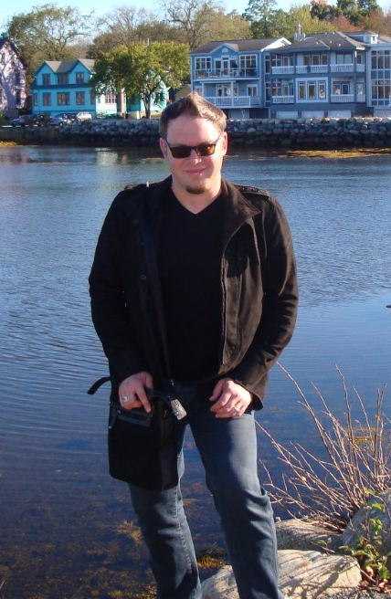
Let’s hear from some of our instructors
Brian Deruiter has a PhD in North American indigenous cinema. Here he tells you a bit about what you will learn in his courses, including CANA 1F91, CANA 2P91 and CANA 2P92.

Slide 24
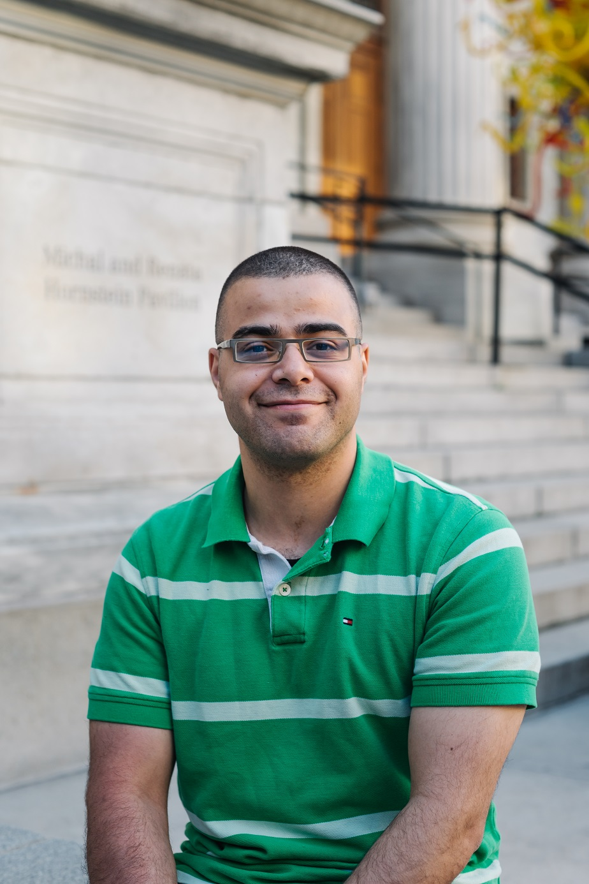
Let’s hear from some of our instructors
Ibrahim Berrada teaches in the Centre for Canadian Studies and is finishing his PhD in Canada-US relations. He has also worked on parliament hill so knows Canada from a whole different perspective! Here he gives you a sense of what you can do with a Canadian Studies degree.

Slide 25
How about a student perspective
Sarah Cavanagh received the James Nicks Memorial Prize in Canadian Studies for 2019
Here she talks about her experience in CANA 3P95 and how it changed her perspective of Canada and the world.

Slide 26
Canadian Studies in the News
Canadian Studies and our guest experts help people make sense of what is going on in the world. Here are a few things we have done recently.
https://brocku.ca/brock-news/seen-and-heard/murdoch-mysteries-creator-draws-full-house-at-brock/
https://brocku.ca/brock-news/seen-and-heard/guest-lecturer-talks-history-of-labatts-brewing/
https://brocku.ca/brock-news/2020/04/disrupted-project-brings-researcher-closer-to-brock-community/
https://brocku.ca/brock-news/2020/03/brock-expert-believes-pandemic-is-being-used-to-further-complicate-border-issues/

Slide 27
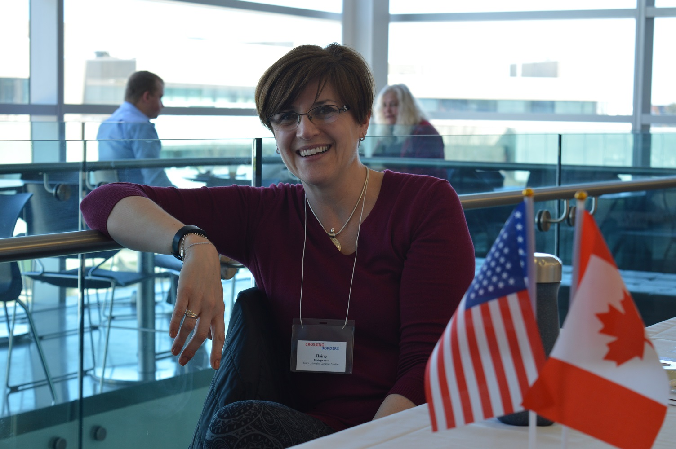
Who is in the Canadian Studies office?
Elaine Aldridge-Low is the administrative assistant and event coordinator of Canadian Studies. When you visit our offices, she will help you out!

Slide 28
Contact Us
brocku.ca/canadianstudies
canadianstudies@brocku.ca
905-688-5550 x4029

Slide 29
Photo credits
Stock photos are in the public domain and come from the following sources
Tulips and tower – from https://www.nbc.ca/personal/advice/immigration/getting-settled-in-canada-in-8-easy-steps.html
Lake in Canada – from https://www.pexels.com/photo/alberta-amazing-attraction-banff-417074/
Toronto sign https://www.pexels.com/photo/people-gathered-in-front-of-toronto-freestanding-signage-1750754/
Canada shoes https://www.pexels.com/photo/close-up-fashion-footwear-legs-1151067/
Vancouver false creek with science world https://www.pexels.com/photo/canoes-beside-dock-1630885/
Peggy’s Cove https://www.pexels.com/photo/lighthouse-by-the-cliff-1788746/
Coffee mug in water https://www.pexels.com/photo/red-ceramic-mug-3021055/
Queens park to CNT https://www.pexels.com/photo/architecture-buildings-city-cn-tower-137581/
Quebec Buggy https://www.pexels.com/photo/men-riding-a-horse-carriage-2887578/
NFalls https://www.pexels.com/photo/waterfalls-under-blue-sky-and-white-clouds-3490963/
Buildings and flag https://www.pexels.com/photo/low-angle-photography-of-high-rise-buildings-3727074/
Windmills https://www.pexels.com/photo/photo-of-windmills-during-dawn-3608056/
Falls and ice https://www.pexels.com/photo/niagara-falls-1739264/
Flag in mountains https://www.pexels.com/photo/canada-flag-with-mountain-range-view-756790/
Canada globe https://www.pexels.com/photo/antique-antique-globe-antique-shop-antique-store-414916/
Canada flag backpack Photo by Andrew Ly on Unsplash https://unsplash.com/photos/WbwuCPNA1Ag
Rainbow plus maple leaf Photo by Toni Reed on Unsplash https://unsplash.com/photos/NyEdi8YBqTg
Three flags Photo by m j on Unsplash https://unsplash.com/photos/SHqsj6TK7x4

